Slide 1
Investigation of the Effects of Mental Fatigue on Programming Tasks
Saurabh Sarkar
North Carolina State University
Adviser – Dr. Christopher Parnin

Slide 2


Motivation
Notes:
Demand for quality software
Emphasizes performance over the health of the developers
Expectation of long work-hours and participation in death marches
Errors in software can be due to low performance of developers, often as a direct result of absentmindedness or exhaustion
Unfortunately, this can also affect their peers and the company they work for when the applications they are working on have to be integrated and scaled. In addition, there is a reluctance of transmitting negative project status information to the upper ranks of the organizational members. This makes it difficult for the decision makers to take appropriate actions at the right time.
Very little research is carried out in assessing the risk when programming
http://nerdiwear.com/website-developer-eyewear/
http://dyn.com/blog/email-marketing-delivery-list-fatigue-deliverability-sending-too-much/

Slide 3

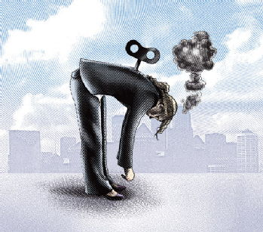
Fatigue
Physical/Muscular Fatigue
Emotional Fatigue
Mental Fatigue
Skills Fatigue
Notes:
Fatigue is a physiological state of reduced mental or physical capability. It results from excessive workload (both physical and mental), exhaustion, or sleep-loss. However, this definition is ambiguous as it is very broad and general. Fatigue (also called exhaustion, tiredness, and lethargy) is a complex phenomenon surrounding several physiological and psychological characteristics.
http://www2.warwick.ac.uk/services/ldc/researchers/community/networks/fatigue/
http://www.belladogmagazine.com/

Slide 4
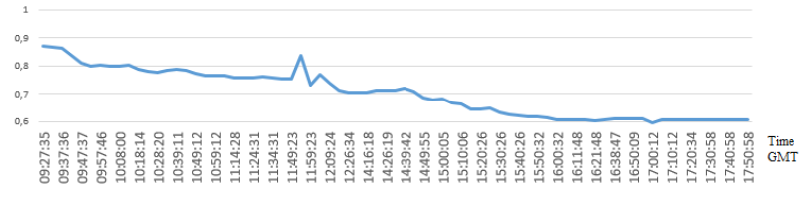
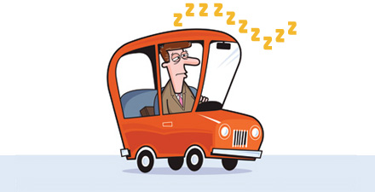
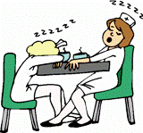

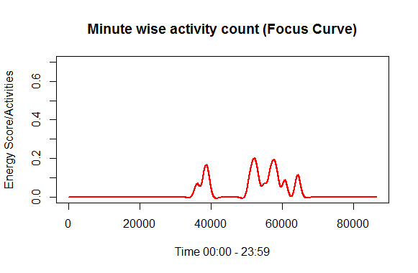
Background
Pimental et. al. (2014)
Notes:
Cognitive studies traditionally deal with the human mind and its processes. Concepts such as reasoning, perception, intelligence, learning, memory and emotion are studied in detail.
Researchers have studied the cognitive issues responsible for several problems developers experience.
http://www.colorado.edu/ics/
http://www.paperless-insurance.com/100-car-naturalistic-driving/
http://www.brightstarcare.com/sw-pittsburgh/2012/01/08/nurse-fatigue-and-patient-safety/
Measuring Fatigue Dr Michelle Millar, Technical Officer (Human Performance), ICAO Asia-Pacific FRMS Seminar Bangkok – 2012

Slide 5
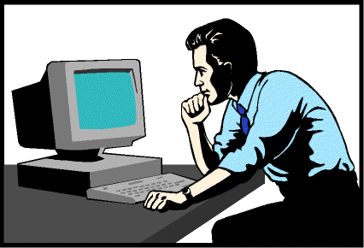
Thesis Statement
We can discover the fundamental causes and effects of mental fatigue in developers and identify the predictors of fatigue based on a developer’s interaction history.
Contribution
Study 1: Discovered six effects of fatigue
Study 2: Defined predictors of fatigue from developer’s interaction history
Notes:
Our overall research goal is to investigate symptoms related to programming when fatigued and to identify potential ways to predict the occurrence of fatigue. Broader impacts include the potential for establishing workplace guidelines for software development work and tools for flagging code which may need further inspection.

Slide 6
Survey
Study 1

Slide 7
Initial Research Questions
RQ1: How severely and frequently does fatigue impact developer productivity?
RQ2:
What are the causes leading to mental fatigue in a programmer’s life?
What are the effects of mental fatigue in a programmer’s life?

Slide 8
Participants and Method
311 participants
Age distribution from 17 to 74. Around 50% of the participants are between the age of 20 to 35
11 questions grouped into categories: sleep, fatigue, work
Sorting of the responses
Card Sorting
Correctness of prediction: 70% & 87%
Notes:
The questions about sleep were designed to get information regarding their sleep habits and circadian rhythm. Fatigue questions were asked to learn about their views on the fatigue in programming. We derived questions related to work to get information about their work habits and performance. They were intended to provide context for our interpretation.
To avoid observer bias, initial card sorting was performed by both the authors and was taken further for more analysis only after achieving a satisfying inter-rate agreement score.

Slide 9
Responses
RQ1
66% of the respondents thought it has a high severity
59% of the respondents thought it has a high frequency
RQ2: a) Causes
Stress
Sleepiness
Non-Willingness
Mood
Physical Work
Notes:
Stress and sleepiness are the highest ranked factors, which validates our definition of mental fatigue in programming tasks’, that triggers from sleepless nights and day-long work. Physical activities often play a role in triggering exhaustion as well. We found mood among the selected causes, which is already considered having an effect on programmer’s debugging performance [Kha11].

Slide 10
RQ2: Effects
Performance
Mental Work-set
Take longer to complete a task. Hold less information in my head. Easily distracted. Make more silly mistakes.
Take longer to complete a task. Hold less information in my head. Easily distracted. Make more silly mistakes.
Take longer to complete a task. Hold less information in my head. Easily distracted. Make more silly mistakes.
Take longer to complete a task. Hold less information in my head. Easily distracted. Make more silly mistakes.
Take longer to complete a task. Hold less information in my head. Easily distracted. Make more silly mistakes.
Focus
Errors
Notes:
Each of the factors are intertwined in a way - 100+ responses included multiple factors

Slide 11
Sample Responses
When I am tired I cannot come up with solutions as quickly, or sometimes not at all, as compared to . . .
Sometimes it’s a boon, other times it harms my productivity. The quality of my works declines drastically . . .
Introducing bugs into code, not deploying latest binaries and being surprised at lack of change in behavior . . .
When I’m tired I lose all desire to continue with the task at hand which is upsetting . . .

Slide 12
Effects of Fatigue
Performance [28.42%] - I couldn't do work as fast
Focus [20.64%] - I couldn't concentrate on work
Productivity [19.03%] - I couldn't do work as well -- it was a hack
Errors/Mistakes [10.72%] - I couldn't work without a lot of errors
Mental Work-set [7.77%] - I couldn't do work with a lot of code
Motivation [7.77%] - I couldn't even start work
Notes:
For carrying out any activity, the context and environment are also very important in determining the level of fatigue during the day. For example, whether it is work-related variables such as motivation, stress, boredom, distractions; or environment-related factors such as ambiance that includes temperature, noise, lighting; or even lifestyle factors such as food, drugs like caffeine, posture, it is important to consider these contextual variables as they can contribute to the fatigue a human being experiences

Slide 13
Threats to Validity
Selection Bias
Survey population may not generalize to all developers
Instrumentation
The fields were not mandatory
Notes:
To mitigate against this threat, the survey as posted on various groups assuming that those groups are mostly accessed by professional software developers but this may.
These type of threats are mostly common in case of online surveys.
To avoid observer bias, initial card sorting was performed by both the authors and was taken further for more analysis only after achieving a satisfying inter-rate agreement score.

Slide 14
OBSERVATION
STUDY 2

Slide 15
Goal
Is the perception of fatigue clear and common to all software developers?
How, when and what kind of tasks developers choose when they are fatigued?
How can we justify developers’ response by their activities?

Slide 16
Participants
Nine professional software developers.
Recruited from online free-lancing websites
Personal contacts
Average industrial experience of 3 to 4 years
Average development work of 8-9 hours
Expertise with the Eclipse IDE (Java)
Geographically diverse population
Study period of about 7 days

Slide 17
Method
Pre-study questionnaire: Sleep Test
User interaction data by DevFatigue (extension of Rabbit)
User Activity
Focus Events
Project Events
Navigation Events
Self Assessment
Daily Survey
Session Survey

Slide 18
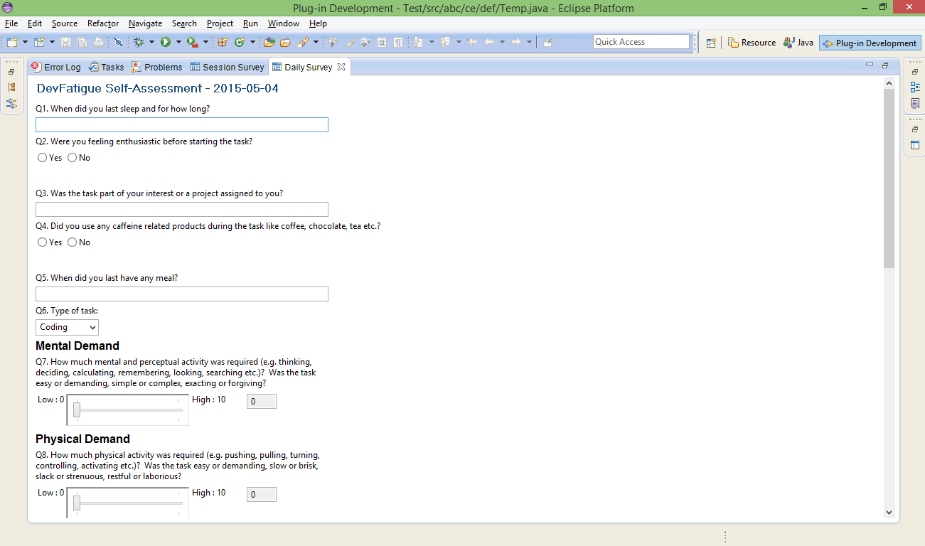
Method
DevFatigue self- assessment survey
Sleep routine
Project Information
Lifestyle
Workload assessment: NASA-TLX (Sandra G. Hart, 1988)

Slide 19
Fatigue Predictors
Performance
Key down time
Time between keys
Time between clicks
Mouse velocity
Mouse acceleration
Focus
Time per file
Navigation
Productivity
Code quality
Goal achieved
Errors
Errors/Corrections
Mental Work-set
Files per time
Systematic manipulation
Motivation
User activities
Key usage
Mouse usage
Time spent
Notes:
For analyzing the relation of the features with fatigue, we used the fatigue score reported by the developers in the DevFatigue daily survey responses. The fatigue was scored using a scale from 0 to 10 and we divided the scores into three level: score 0-3 represents Low, 4-6 represents Medium and 7-10 represents High fatigue levels.
Data tagged by fatigue score
Strong but not significant

Slide 20
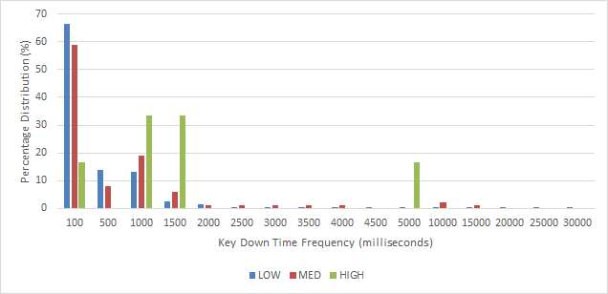
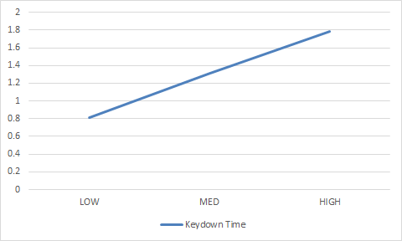
Performance
Spearman’s rank correlation coefficient | ρ = 0.999784
Null hypothesis: A lower fatigue day will have similar weighted average of key down times to a higher fatigue day | p-value = 0.2161
Key-down Time
Notes:
The most common pattern we observed that in a low fatigue level the low frequencies covered around 97% of all the key-down times and rest is distributed among the other frequencies. In case of medium fatigue level, the low key-down frequencies cover only 90% of the distribution and in case of high fatigue level,
it covers around 80% of the distribution. We categorized low key-down frequencies as 1 to 1500 milliseconds

Slide 21
When fatigued, developers:
 | Indicator | Spearman’s rank correlation coefficient (ρ) | p-value
tend to code slower | Key-down time | 0.999784 | 0.2161
tend to code slower | Time between keys | 0.960758 | 0.2305
tend to click mouse slower | Time between clicks | 0.99451 | 0.5815
tend to move mouse slower | Mouse velocity | - 0.78762 | 0.1644
tend to move mouse slower | Mouse acceleration | - 0.62234 | 0.1562

Slide 22
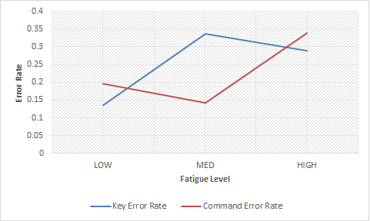
Mistakes/Corrections:
Errors
Spearman’s rank correlation coefficient: Key based rate Command based rate | ρ = 0.732263 ρ = 0.697866
Null hypothesis: A lower fatigue day will have similar mean error rate to a higher fatigue day | p-value = 0.2913

Slide 23
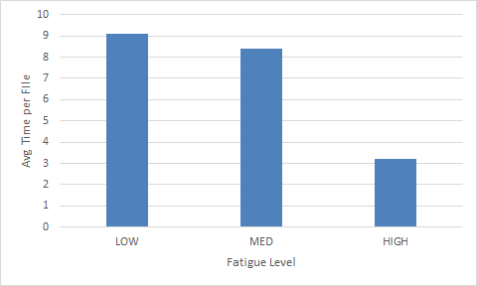
File Transaction:
Focus
Spearman’s rank correlation coefficient | ρ = - 0.91452
Null hypothesis: A lower fatigue day will have similar time per files to a higher fatigue day | p-value = 0.5007

Slide 24
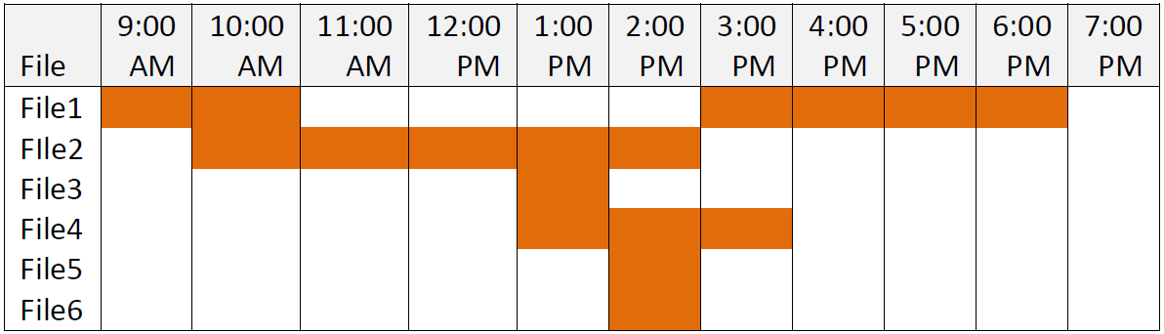
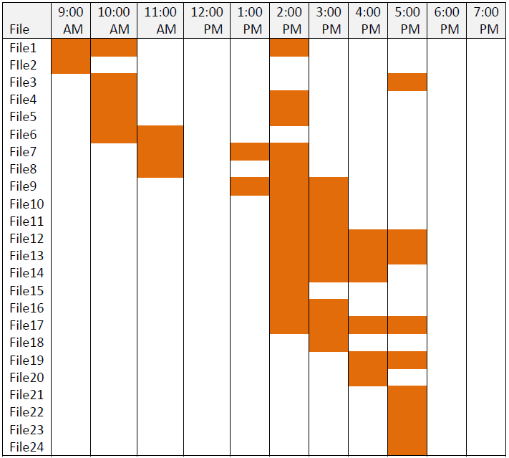
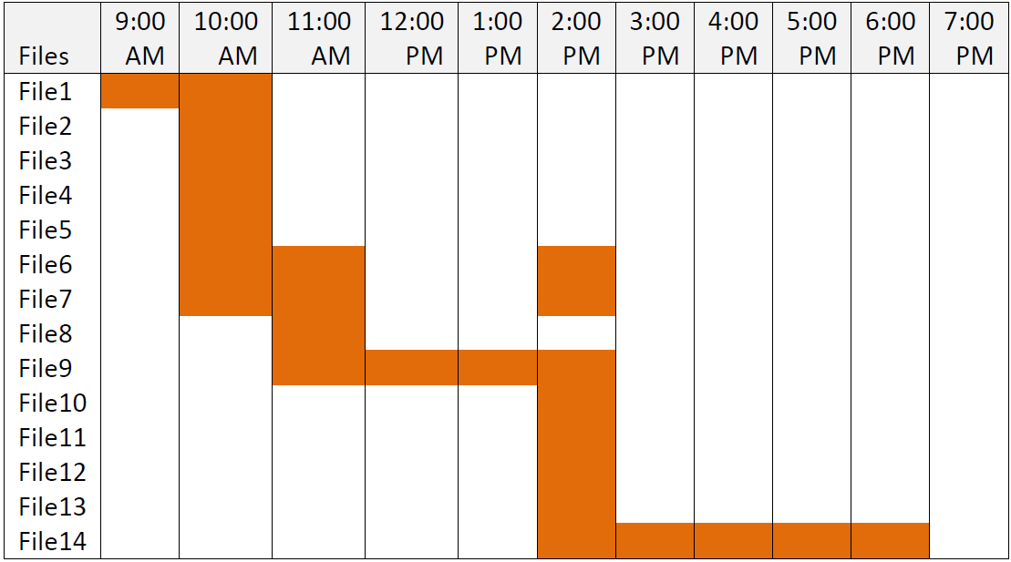
Focus
Low Fatigue Day
High Fatigue Day
Medium Fatigue Day
File Traversal Pattern

Slide 25
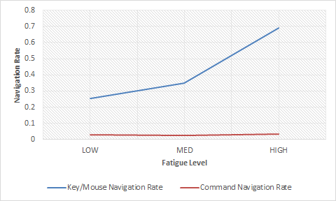
Navigation:
Focus
Spearman’s rank correlation coefficient: Key/mouse navigation Command navigation | ρ = 0.949245 ρ = 0.295376
Null hypothesis: A lower fatigue day will have similar mean navigation count to a higher fatigue day | p-value = 0.4372

Slide 26
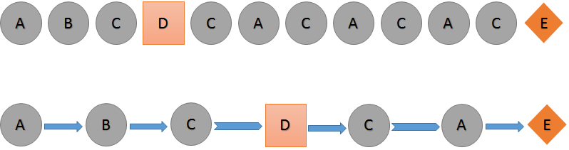
Method Transition:
Focus
Low Fatigue Level |  | Medium Fatigue Level |  | High Fatigue Level
A | 1 | A | 4 | A | 4
B | 5 | B | 1 | B | 1
C | 17 | C | 7 | C | 1
D | 1 | D | 1 | D | 3
E | 1 | E | 2 | E | 2
F | 3 | F | 1 | F | 1
G | 3 | G | 1 | G | 3
H | 1 | H | 1 | H | 1
I | 14 | I | 1
J | 1 | J | 5
K | 1 | K | 4
L | 2 | L | 1
M | 1
N | 1

Slide 27
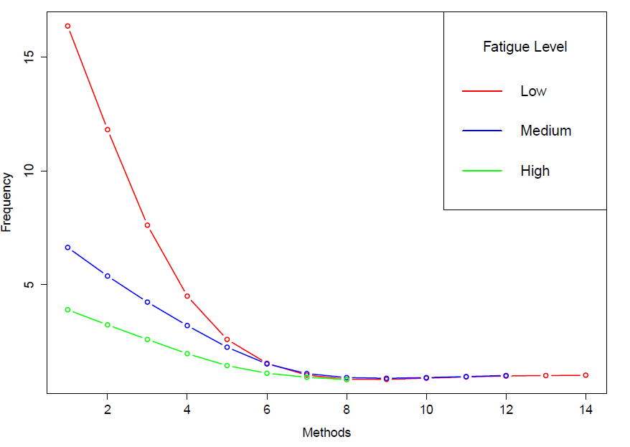
Method Transition:
Focus
Pareto Distribution:
shape parameter α
Low = 1.40392
Medium = 1.709138
High = 1.870616
Notes:
Pareto distribution is used to describe conditions in which an equilibrium is found in the distribution of the "small" to the "large". For example, in describing the distribution of wealth, it is sometimes expressed more simply as the Pareto principle or the "80-20 rule" which says th1at 20% of the population controls 80% of the wealth.
p-value
Low = 0
Medium = 1e-05
High = 1.870616

Slide 28
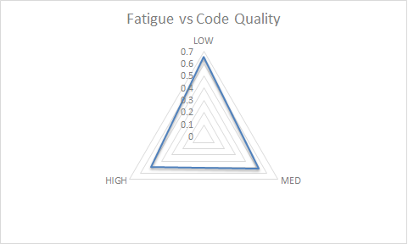
Code Quality:
Productivity
Spearman’s rank correlation coefficient | ρ = - 0.92984
Null hypothesis: A lower fatigue day will have similar code quality score to a higher fatigue day | p-value = 0.1856

Slide 29
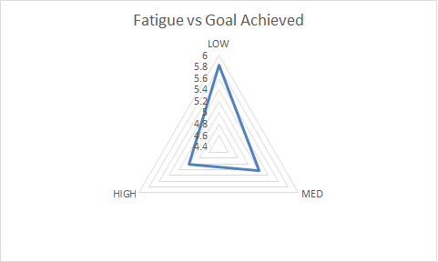
Goal Achieved:
Productivity
Spearman’s rank correlation coefficient | ρ = - 0.96556
Null hypothesis: A lower fatigue day will have similar goal achieved score to a higher fatigue day | p-value = 0.5389

Slide 30
Threats to Validity
Smaller population : 9 Software Developers
Study period : ~7 days
Sleep Disorders
Missing Data
Different perception of fatigue and workload
Developer’s Recognition
Notes:
1. We tried to address this threat by selecting participants from different companies and demographic location to cover a diverse population.
2. We, therefore, asked the other participants to extend their study period by a day or two. Moreover, we used the approach of categorizing the fatigue in different levels according to their scores and used the aggregated average for analysis.
Additionally, people are highly motivated in short-term studies and it may be difficult to measure and project the difference in actual performance.

Slide 31
DISCUSSION

Slide 32
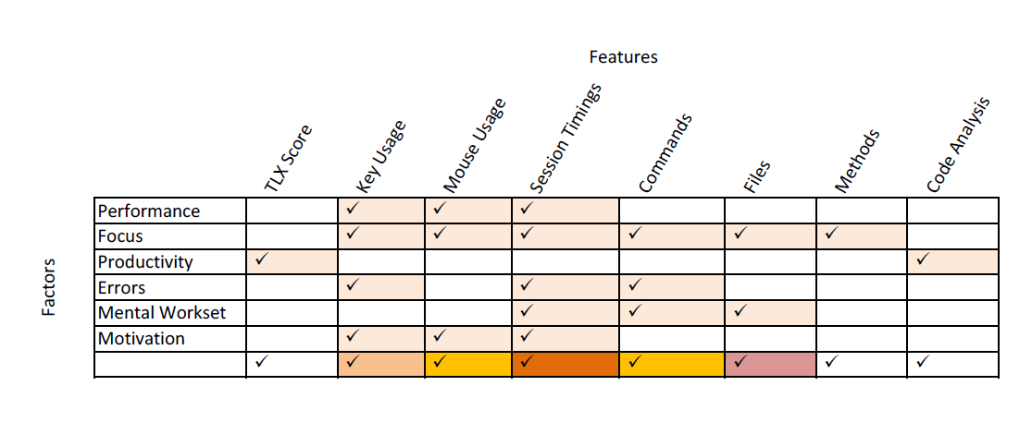
Fatigue Predictors
Notes:
The results achieved from the observation study not only answer the research questions derived from the effects of fatigue, but also, provide evidence that it is indeed possible to analyze and quantify developer’s fatigue level through features collected from monitoring their activities.
These approaches can help the future researchers to come up with a prediction model for detecting fatigue according to user’s work pattern.
Nonetheless, we acknowledge that more accurate approaches can be developed when considering specific context information not yet considered, such as the type of task, factors like caffeine consumption, effect of sleep or food or other environmental factors discussed earlier.
Though an approach of a controlled experiment using physiological sensors such as pulse detectors and eye tracking devices could provide a different platform for tagging and analyzing data.

Slide 33
Interventions
Explicit management of the working time and effort invested in each task
Breaks at work
Evaluation of feasibility of timeline
Survey Responses : “Switch to other tasks and until you regain your concentration.” – 45%
Notes:
In the daily life of a software developer, they frequently have the inclination of being depleted because of mental or physical work and a feeling of degradation in the quality of the simplest tasks. There are days when a developer’s ability of performing a task is at its worst or some days when his performance diminishes slowly as the day advances. This deprivation in the efficacy, whether physical or mental, is linked to the onset of fatigue.
(a) Continue working until the work is completed
(b) Switch to other tasks until you regain your concentration
(c) Stop working and rest

Slide 34
Interventions
Coping Mechanisms
Alerts
Screen freezes
Pomodoro Technique - “I think slower, and start becoming distracted. But I found that using a Pomodoro Timer can keep my energy up and myself focused.”
Flagging code for further inspection
Notes:
The awareness of developer’s fatigue level may provide a decision-support system that will improve the quality of their life and thus work.
The next step for the future researchers and developers would be to use the predictors and develop a tool that could be used to monitor and report fatigue in industry. This research holds a value in the industry setting some design guidelines and aims to help the developers get rid of their fatigue state.

Slide 35
Conclusion
Survey Study: Discovered six effects of fatigue
Observation Study: Defined predictors of fatigue from developer’s interaction history
Fundamental guidelines for building a model to predict/detect fatigue in industry

Slide 36
Future Directions
More research to identify the adverse effects of fatigue with large data set
Controlled experiments using physiological sensors
Coping Strategy for Fatigue
Development of real-time systems for fatigue monitoring and classification through the defined predictors
Models could be built depending on user specific patterns to identify them
Notes:
We hope this study will encourage similar approaches to continue investigating different ways to alleviate mental fatigue.

Slide 37
THANK YOU!!
☺

Slide 38
BackUp Slides

Slide 39
Usage Data Collector
More than 50000 records were available for each user.
Analyze 100 days sessions of 2 users.
Paired t-test (two tailed)
Firstly, we considered day of week
Secondly, we considered session time
H₀: The energy level of day time sessions would be similar to night time sessions of a user.
H₁: The session durations of day time sessions would be similar to night time sessions of a user.
Notes:
UDC is a framework in Eclipse to collect usage data information. UDC data sets contain the activity information of a particular user, specially the commands used through a session.

Slide 40
Usage Data Collector
User | Hypothesis | Null-Hypothesis (p-score) | Rejected at α = 0.05
1 | H₀ | 0.001663433
 | H₁ | 0.19836863 | X
2 | H₀ | 0.959305717 | X
 | H₁ | 0.331089607 | X
Notes:
H1 is accepted for both the users but the score makes us think again about the possibility that it might be rejected for some other sessions. We have compressed the data before processing rst by averaging it for a time session and then normalizing, that might have lost some low level information.

Slide 41
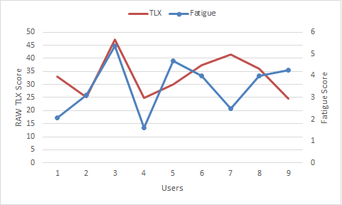
NASA-TLX vs FATIGUE
Notes:
We observed that for some users relation between the fatigue and TLX score is diverging. For example, there are times when a developer would only take on a "hard" task if he is feeling "awake". We found out that in some scenarios task difficulty can be a distinct factor from fatigue.

Slide 42
File Traversal Pattern:
Focus
High Fatigue Day
Low Fatigue Day
Medium Fatigue Day

